Slide 1
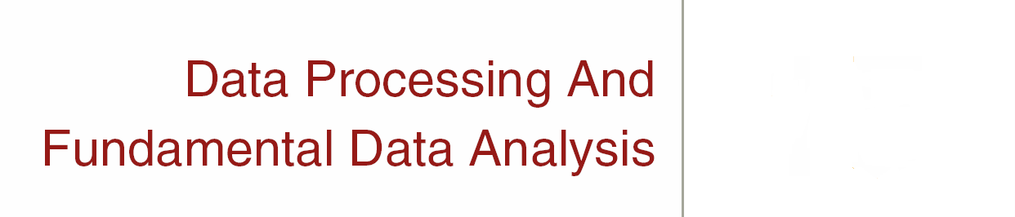
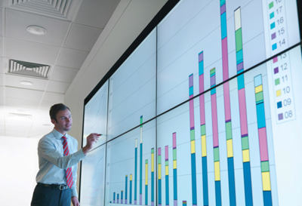
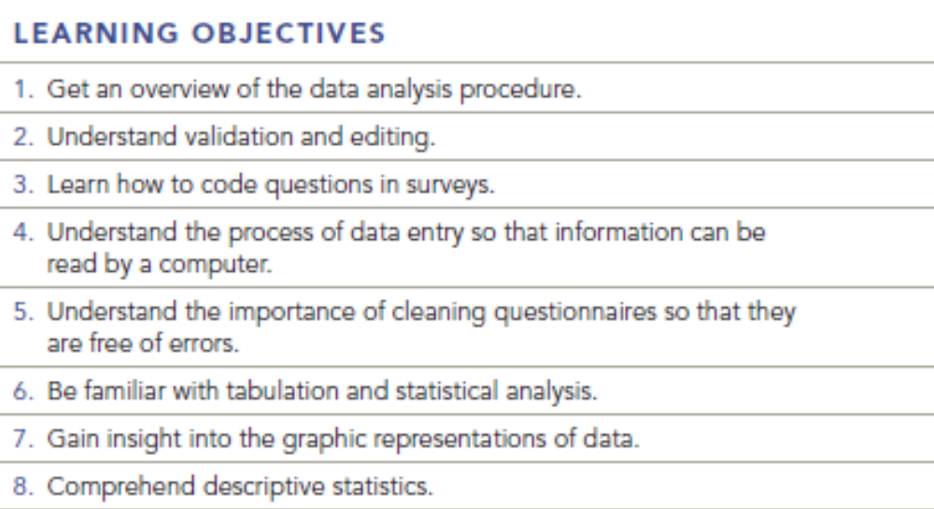
Chapter Fifteen
15-1

Slide 2
Overview of the Data Analysis Procedure
The Key Steps:
1
2
3
4
5
Validation &
Editing
Coding
Data
Entry
Logical
Cleaning
of Data
Tabulation &
Statistical
Analysis
15-2
Key Terms & Definitions

Slide 3
Overview of the Data Analysis Procedure
Step One:
  Validation: Process of ascertaining that interviews actually were conducted as specified.
  Editing: Process of ascertaining that questionnaires were filled out properly and completely.
  Skip Pattern: Sequence in which later questions are asked, based on a respondent’s answer to an earlier question or questions.
Step Two:
  Coding: Process of grouping and assigning numeric codes to the various responses to a question.
Step Three:
  Data Entry: Process of converting information to an electronic format.
  Intelligent Data Entry: Form of data entry in which the information being entered into the data entry device is checked for internal logic.
  Scanning: Form of data entry in which responses on questionnaires are read in automatically by the data entry device.
15-3
Key Terms & Definitions

Slide 4
Skip Pattern
“If MALE, go to question 3; if FEMALE, go to Question 4.”
Notes:
If the skip pattern is not followed correctly, then unnecessary and inappropriate questions may be asked and error may be introduced in interpreting the respondents’ answers

Slide 5
Question
An interviewer, completed 50 questionnaires.
Further validation: Ten of the questionnaires.
A) Claimed age category was 30-40,
Marked category was 20-30.
B) “What is the most important problem facing our city government?”
  “The city council is too eager to raise taxes.” (interviewer wrote)
  In validation, “The city tax rate was too high.” (response from the respondent)
As a valuator would you assume that these were honest mistakes and accept the entire lot of 50 interviews as valid? If not, what would you do?

Slide 6
Answer
The error on the first questionnaire may have simply been a missed stroke of the pencil or computer.
The second mistake, which is a completely different answer with similar content, gives cause for more concern.
Check another ten questionnaires to see if more mistakes crop up. It may be that all the questionnaires should be validated.

Slide 7

Overview of the Data Analysis Procedure
Step Four:
  Clean the Data: Check for data entry errors or data entry inconsistencies.
  Logical or Machine Cleaning: Final computerized error check of data.
  Error Check Routines: Computer programs that accept instructions from the user to check for logical errors in the data.
  Marginal Report: Computer-generated table of the frequencies of the responses to each question, used to monitor entry of valid codes and correct use of skip patterns.
Step Five:
  Data Analysis – e.g. One Way Frequency Tables: Table
  showing the number of respondents choosing each answer
  to a survey question.
  Cross Tabulation Tables - Examination of the responses to
  one question relative to the responses to one or more other
  questions.
15-4
Key Terms & Definitions

Slide 8
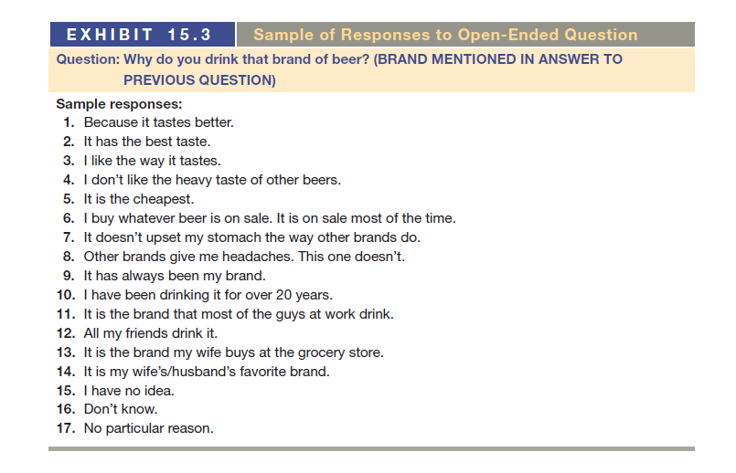

Slide 9
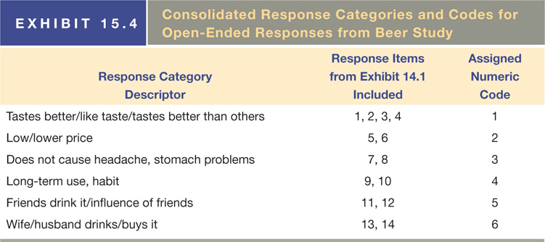
The Coding Process
15-7
Key Terms & Definitions

Slide 10
QUESTION: How do you think the taste of Pepsi compares with Coca Cola?
Responses: The taste of Pepsi was
1) Better
2) Sweeter
3) Too sweet
4) Not as refreshing
5) More refreshing
6) Sweeter is better
7) Bolder taste
8) They taste about the same
9) I don’t know
10) I don’t have any idea
11) I don’t drink soft drinks
12) Soft drinks are not good for you
13) Not a refreshing as Coca Cola
14) Coca Cola has always been my favorite brand

Slide 11
QUESTION: How do you think the taste of Pepsi compares with Coca Cola?
Responses: The taste of Pepsi was
1) Better
2) Sweeter
3) Too sweet
4) Not as refreshing
5) More refreshing
6) Sweeter is better
7) Bolder taste
8) They taste about the same
9) I don’t know
10) I don’t have any idea
11) I don’t drink soft drinks
12) Soft drinks are not good for you
13) Not as refreshing as Coca Cola
14) Coca Cola has always been my favorite brand
Notes:
Ans: Consolidated Response Categories Codes
Taste – sweetness 2, 3, 6
Refreshing 4, 5, 13
Preferred 1, 14
Direct Comparison 7, 8
Don’t know/don’t drink soft drinks 9, 10, 11
Health statement 12

Slide 12
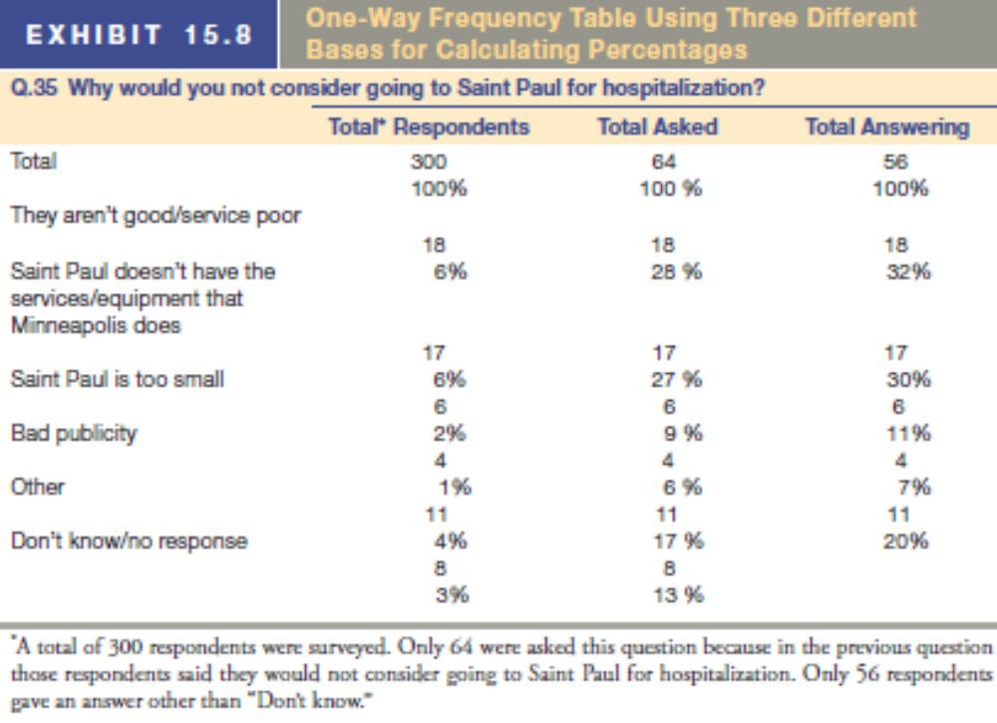
One Way Frequency Tables
15-8
Key Terms & Definitions

Slide 13
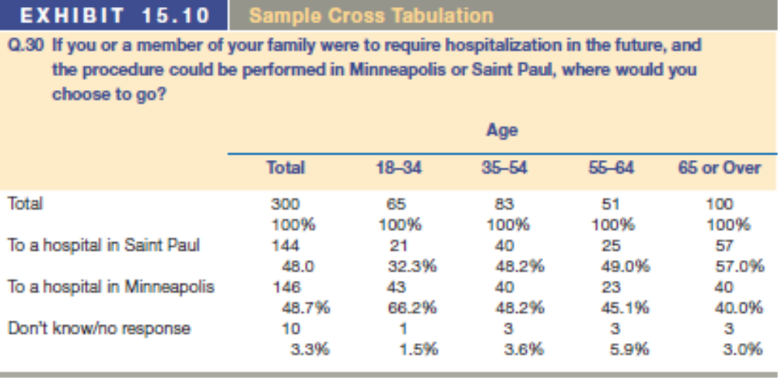
Cross Tabulations Examples
15-9
Key Terms & Definitions

Slide 14
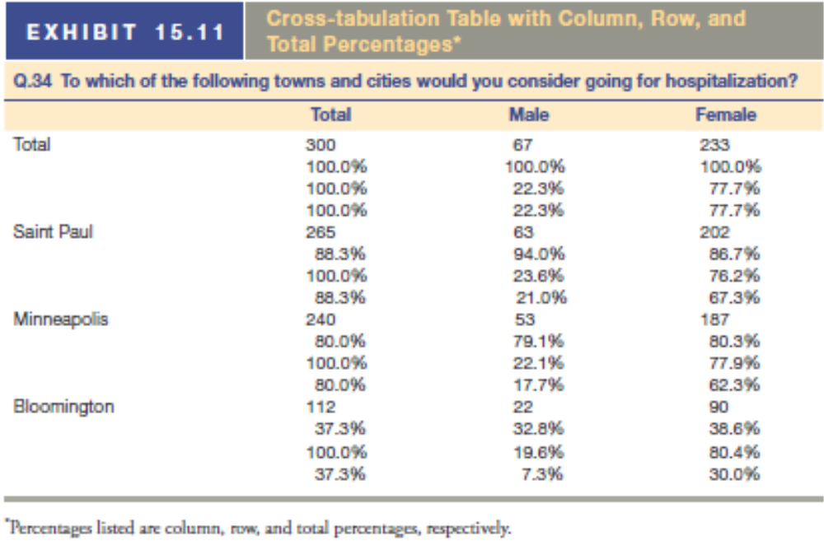
Cross Tabulations Examples
15-10
Key Terms & Definitions

Slide 15
Cross Tabulations Examples
Among all male respondents, 94%-Saint Paul, 79.1%-Minneapolis, 32.8% - Bloomington
Among all female respondents, 86.7%-Saint Paul, 80.3%-Minneapolis, 38.6% - Bloomington

Slide 16
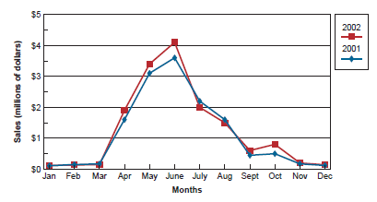
Graphic Representations of Data
Line Charts:
Good for demonstrating linear relationships
Particularly useful for presenting
a given measurement taken at several points over time
15-11
Key Terms & Definitions

Slide 17
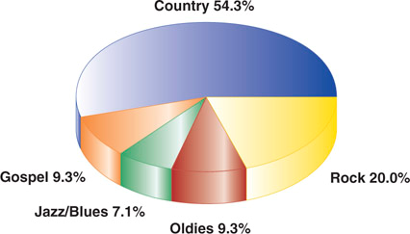
Graphic Representations of Data
Pie Charts:
Good for special relationships among data points
Should total to 100%
15-12
Key Terms & Definitions

Slide 18
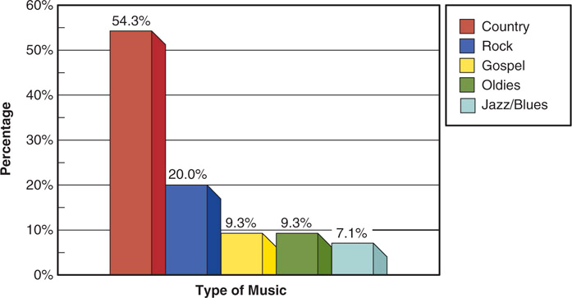
Graphic Representations of Data
Bar Charts:
Good for side by side relationships / comparisons
Most flexible of the graphs
15-13
Key Terms & Definitions

Slide 19

Descriptive Statistics
Measures of
Central Tendency
Mean:
  The sum of the values for all observations of a variable divided by the number of observations.
Median:
  Value below which 50 percent of the observations fall.
Mode:
  The value that occurs most frequently.
15-15
Key Terms & Definitions

Slide 20
Measures of Dispersion
These measures indicate how spread out the data are:
Variance:
  The sums of the squared deviations from the mean divided by the number of observations minus one.
  The same formula as standard deviation with the squaring.
Range:
  The maximum value for a variable minus the minimum value for that variable.
Standard Deviation:
  Measure of dispersion calculated by subtracting the mean of the series from each value in a series, squaring each result, summing the results, dividing the sum by the number of items minus 1, and taking the square root of this value.
15-16
Key Terms & Definitions

Slide 21
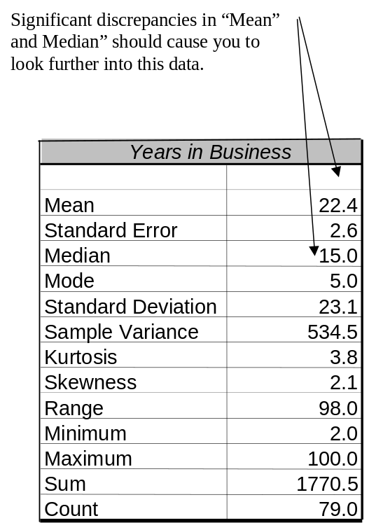
Descriptive Statistics
Descriptive statistics are the most efficient means of summarizing the characteristics of large sets of data. In a statistical analysis, the analyst calculates one number or a few numbers that reveal something about the characteristics of large sets of data.
15-17
Key Terms & Definitions

